Slide 1

human stress DETECTION AND
PREDICTION USING ANN
TEAM - 2
TEAM MEMBERS:
ABHISHEK SRIRAM(TEAM LEADER)
JYOSNA
SWAPNA
SIDDHI
ANUSHRI

Slide 2


contents
01 - INTRODUCTION
02 - PROBLEM STATEMENT
03 - ABOUT PARAMETERS
04 - MILESTONE - 1 : DATA PREPROCESSING AND VISUALIZATION
05 - MILESTONE - 2 : MODEL ARCHITECTURE
06 - MILESTONE - 3 : MODEL BUILDING AND EVALUATION
07 - MILESTONE - 4 : MODEL DEPLOYMENT
08 - HOME PAGE
09 - ABOUT PAGE
10 - SIGNUP PAGE
11 - LOGIN PAGE
12 - DATA ENTRY PAGE
13 - RESULT PAGE
14 - DATABASE INTEGRATION
15 - CONCLUSION

Slide 3
INTRODUCTION
Human stress is the body's response to challenging or demanding situations, activating a range of physical and mental reactions aimed at coping with perceived threats.
Stress can influence focus and performance. chronic stress can lead to negative effects on physical and mental health, including anxiety, high blood pressure, sleep disorders, and weakened immunity. Identifying and managing stress is essential for maintaining overall well-being and preventing long-term health issues.

Slide 4

Problem Statement
This project aims to build a system that detects human stress levels during sleep using physiological data. An Artificial Neural Network (ANN) is trained to classify sleep data as "Stressed" or "Not Stressed”.

Slide 5



Integrated Development Environments: VSCode and Jupyter Notebook
Visual Studio Code is a lightweight but powerful source code editor that supports a wide range of programming languages, including Python, R, and Java.
Features include extensive library of extensions in the VS Code Marketplace to add tools, themes, and functionality.
Customizable keybindings, themes, and workspace settings.
Jupyter Notebook is an open-source web application that allows you to create and share documents that contain live code, equations, visualizations, and narrative text.
Jupyter Notebook is a highly versatile and interactive web-based development environment.
LEARN MORE

Slide 6

ABOUT PARAMETERS
SNORING RATE
RESPIRATORY RATE
BODY TEMPERATURE
LIMB MOVEMENT
BLOOD OXYGEN
EYE MOVEMENT
SLEEP HOURS
HEART RATE

Slide 7
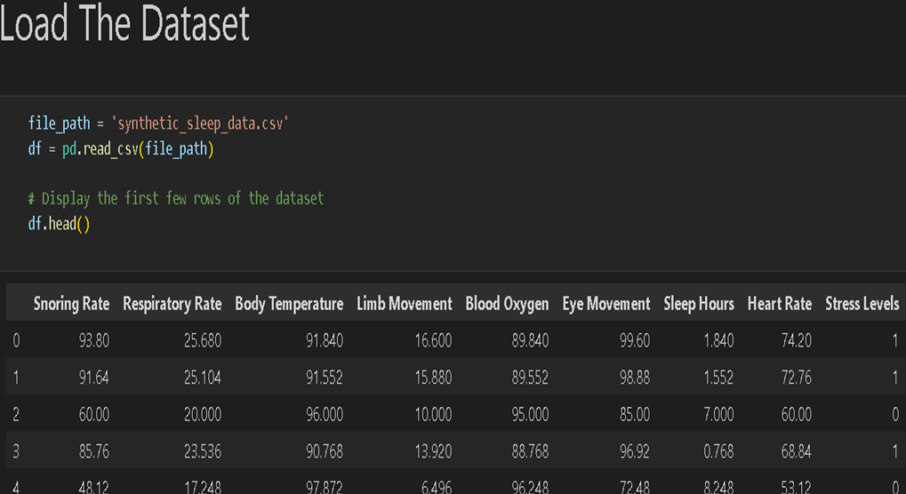


MILESTONE - 1 : DATA PREPROCESSING AND VISUALIZATION
1) DATA PREPROCESSING:
01
Data Collection
We gathered data from various sources, including wearable sensors and physiological recordings.
02
Data Cleaning
We cleaned and preprocessed the data to ensure accuracy and consistency for model training.

Slide 8
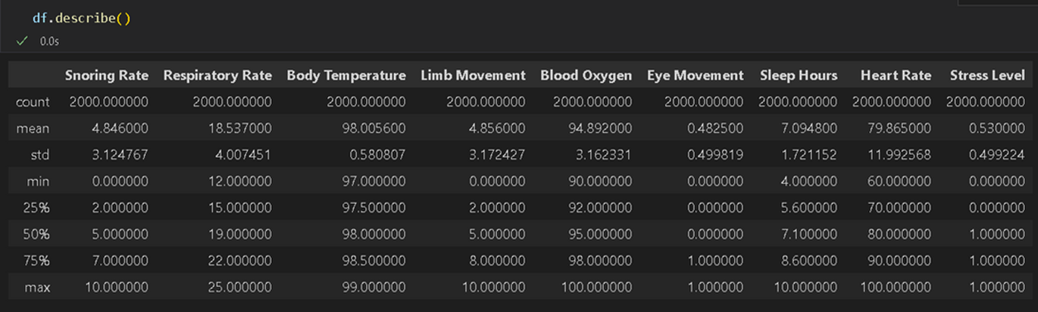
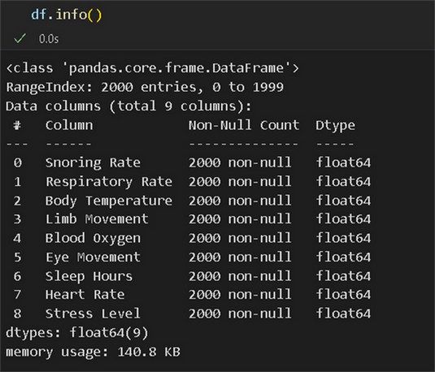
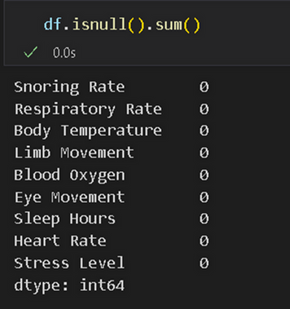
OBTAINED FIVE NUMERICALPOINT SUMMARY
OF THE FEATURES
CHECKED FOR MISSING/NULL VALUES
OBTAINED INFO ABOUT
THE DATATYPE OF THE
FEATURES

Slide 9
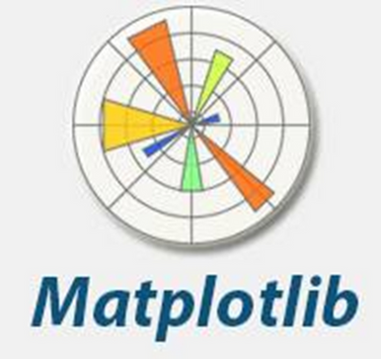



2) DATA VISUALIZATION
Matplotlib is a powerful Python library that provides a wide range of tools for creating static, animated, and interactive visualizations in Python. This library serves as the foundation for the Seaborn library, and both libraries are critical in data analysis and visualization.
Seaborn is a Python data visualization library that is built on top of Matplotlib. It provides a high-level interface for drawing attractive and informative statistical graphics.
Seaborn works seamlessly with Pandas DataFrames, allowing you to visualize data directly from your data tables without converting them to arrays.

Slide 10
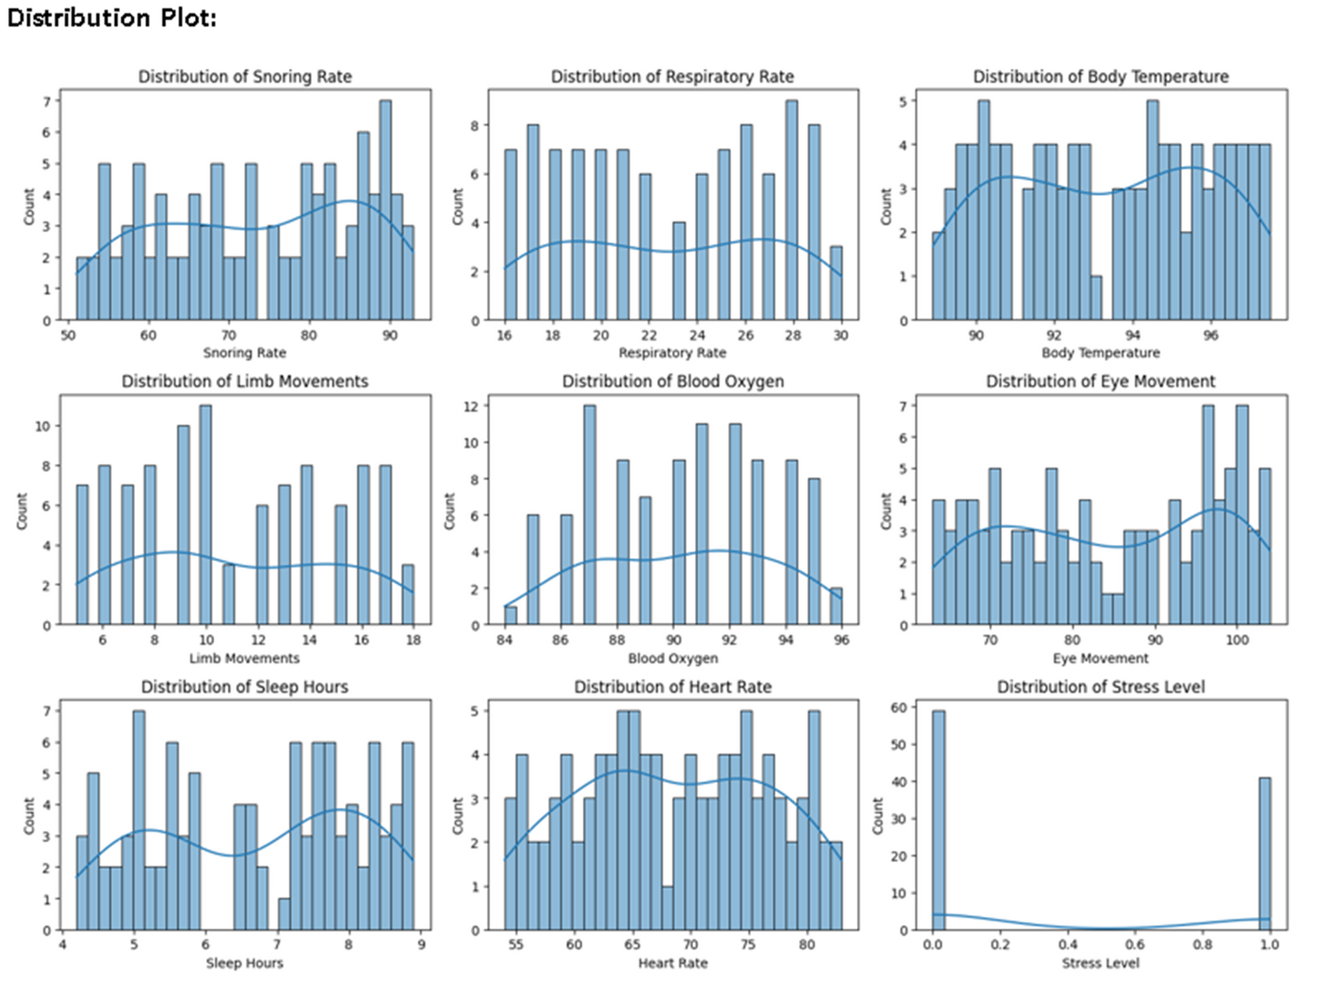

Slide 11
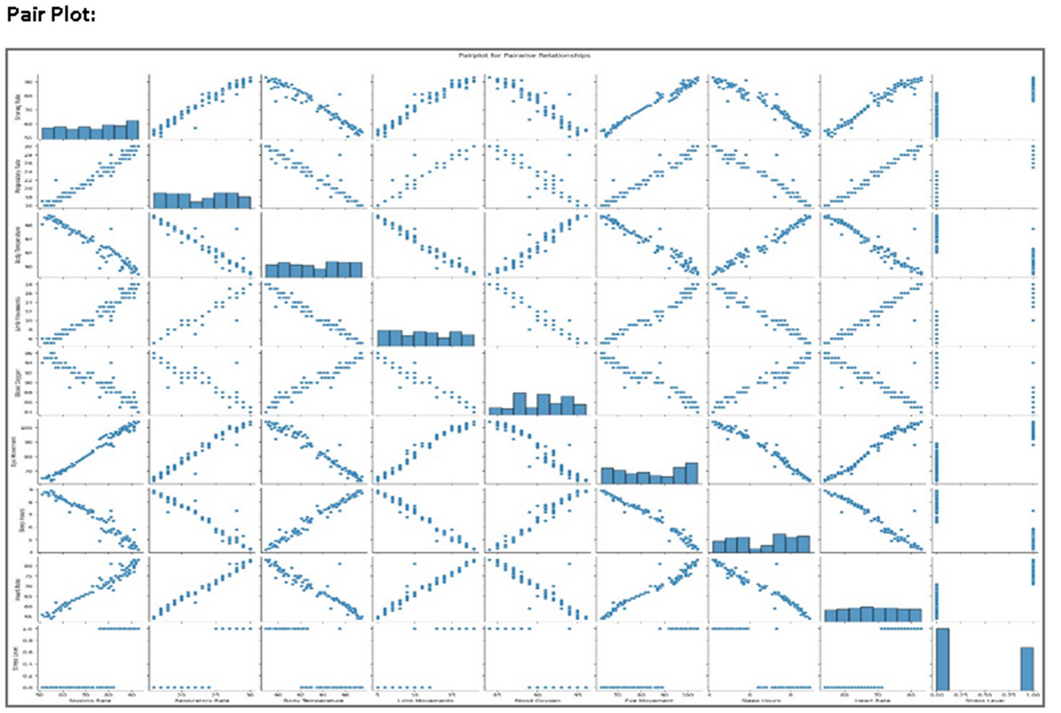

Slide 12
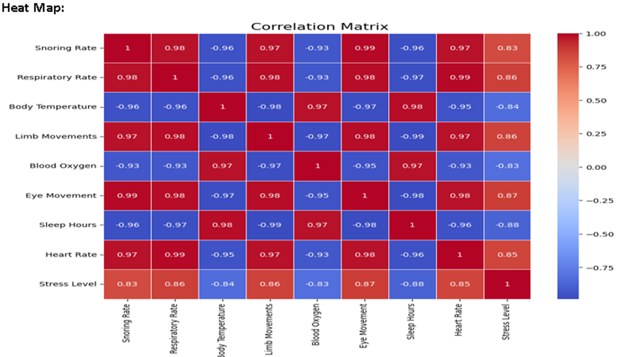

Slide 13
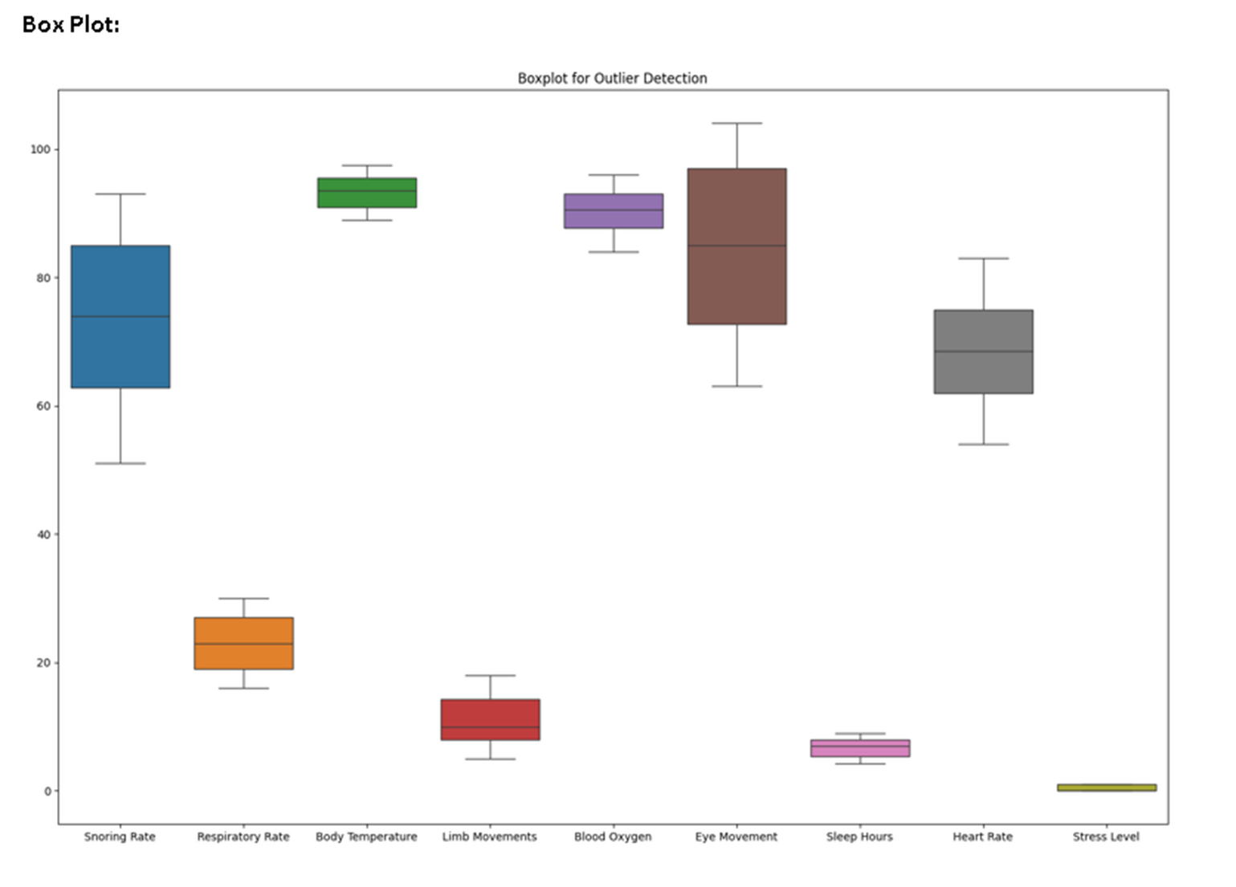

Slide 14
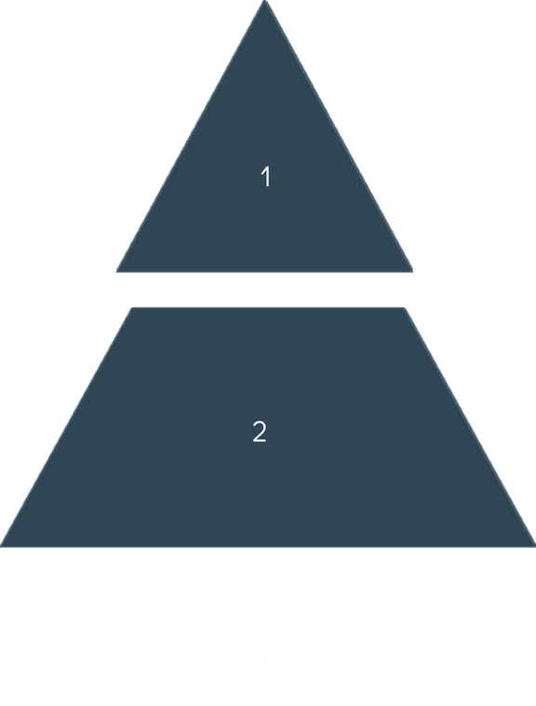
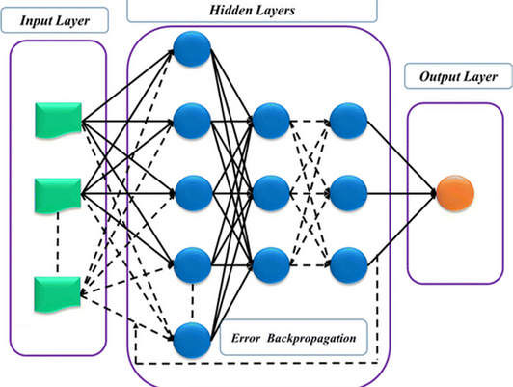

MILESTONE - 2 : MODEL ARCHITECTURE
Input Layer
The input layer receives physiological data, including snoring rate, respiratory rate, body temperature, limb movement, blood oxygen, eye movement, sleep hours, and heart rate.
Hidden Layers
Multiple hidden layers process and extract features from the input data.
Output Layer
3
The output layer generates a prediction of stress levels based on the processed data.

Slide 15
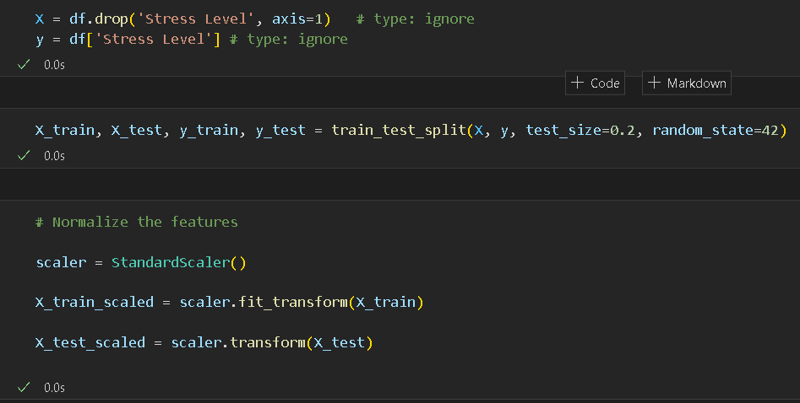
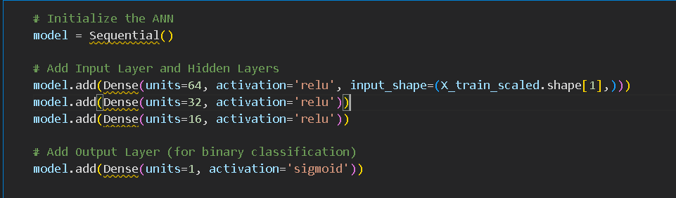
MILESTONE - 3 : MODEL BUILDING AND EVALUATION
1) MODEL BUILDING:

Slide 16
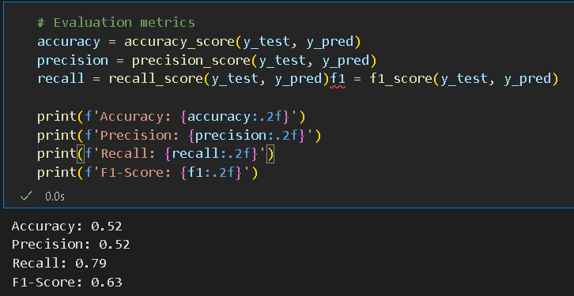


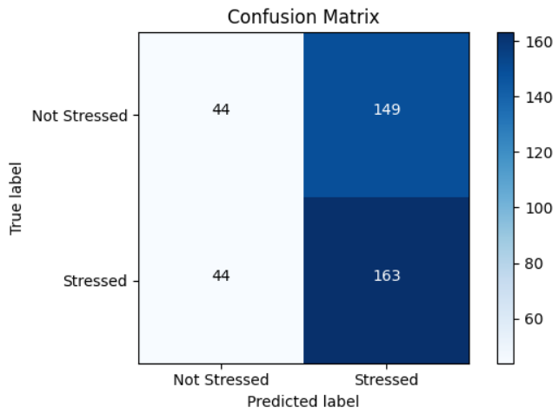

2) MODEL EVALUATION:
1
Training
We trained the model using labeled datasets, optimizing its parameters to achieve high accuracy in stress prediction.
2
Evaluation
We evaluated the model's performance using various metrics, including accuracy, precision, and recall.
Refinement
3
Based on the evaluation results, we refined the model architecture and training parameters to improve its performance.

Slide 17
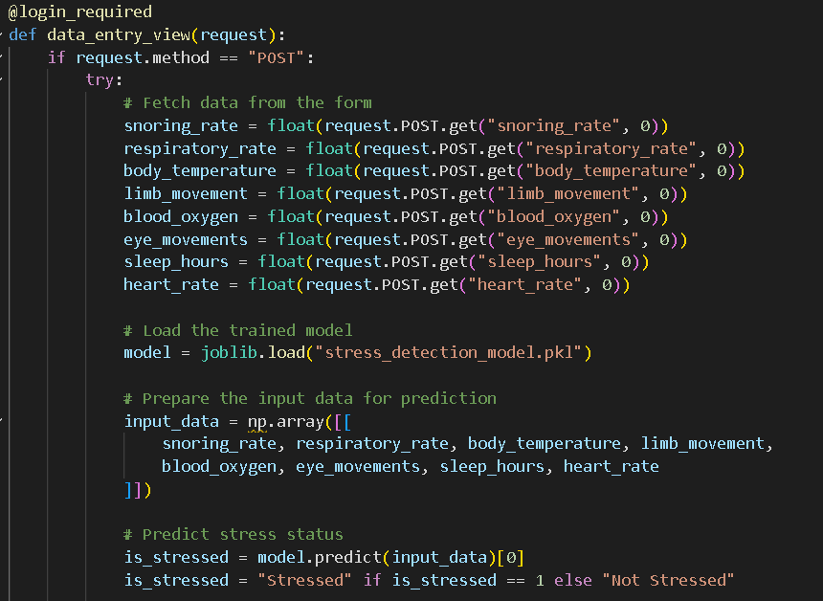


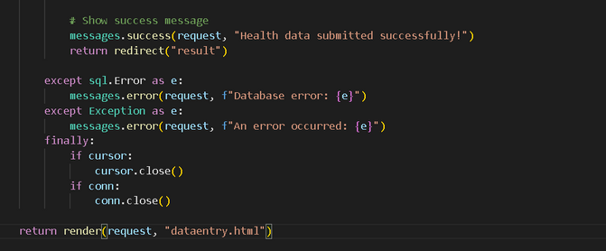

MILESTONE - 4 : MODEL DEPLOYMENT
Web Application
We developed a web application using Django, a Python framework, allowing users to input their data and receive stress prediction results.
Database Integration
We integrated a MySQL database to store and manage user data and prediction results efficiently.
Real-Time Analysis
The application can analyze data in real-time, providing immediate feedback and empowering users to manage their stress proactively.

Slide 18

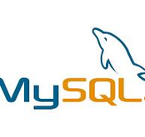
Why Django and MySQL?
Django's robust framework provides a secure and efficient environment for web application development, ensuring scalability and maintainability.
MySQL is a reliable and efficient database management system that handles the storage and retrieval of user data and prediction results with optimal performance.
.

Slide 19
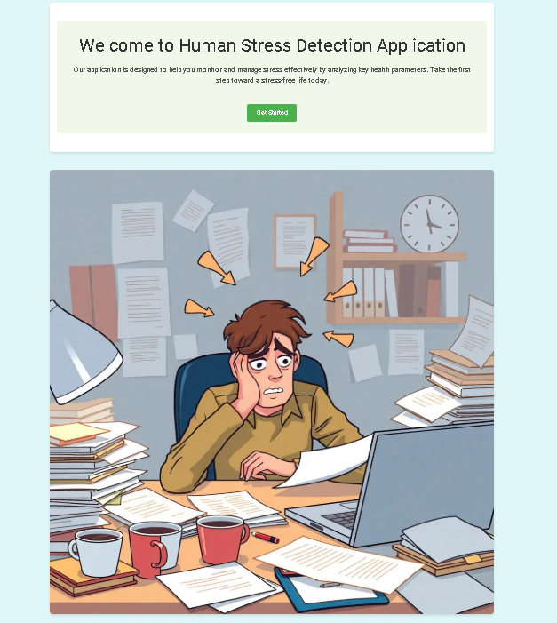
HOME PAGE

Slide 20
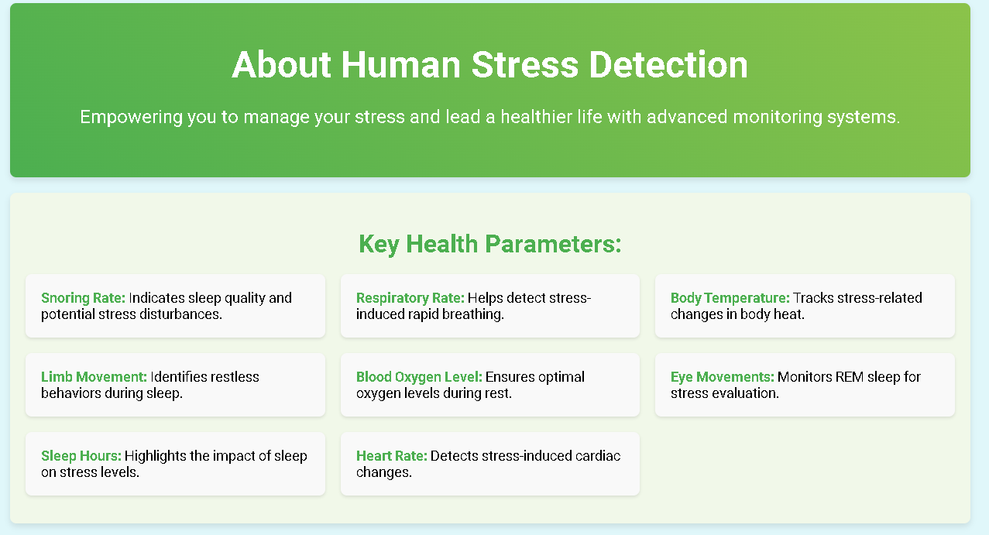
ABOUT PAGE

Slide 21
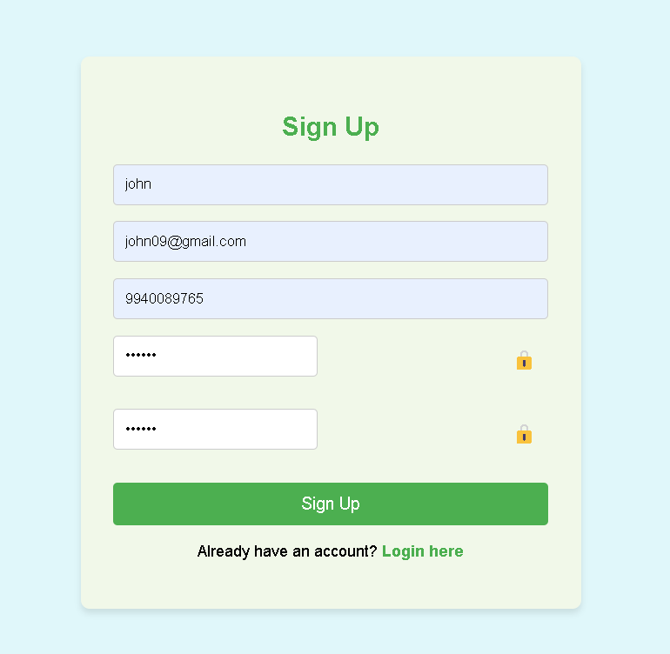
SIGNUP PAGE

Slide 22
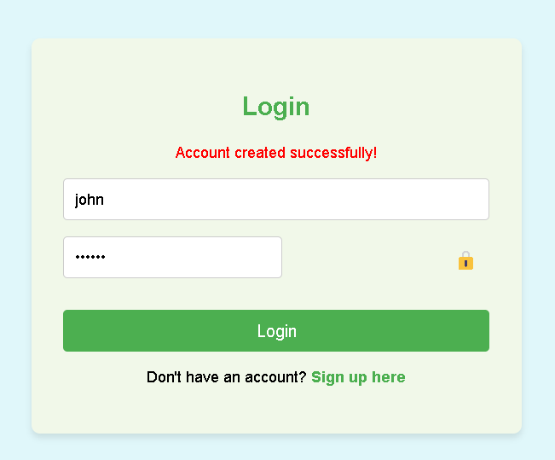
LOGIN PAGE

Slide 23
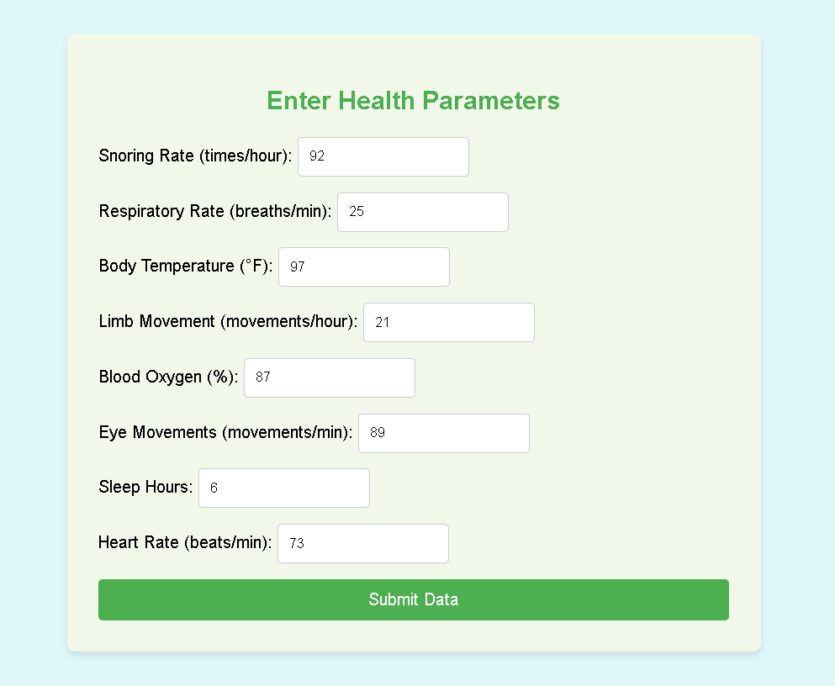
DATAENTRY PAGE

Slide 24
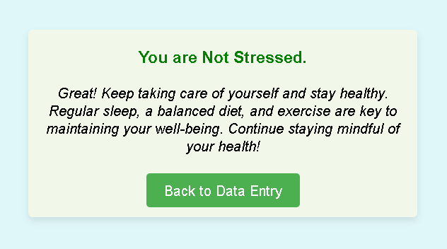
RESULT PAGE

Slide 25
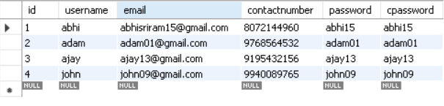
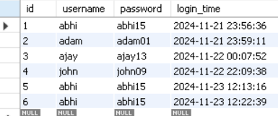
Database Integration
1) SIGNUP TABLE
2) LOGIN TABLE

Slide 26
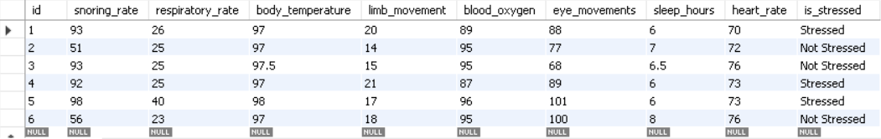
3) HEALTH DATA TABLE:

Slide 27
CONCLUSION
Stress detection systems offer insights into stress levels and their effects on health, especially during critical recovery periods like sleep. With accurate stress monitoring, individuals can take proactive steps to improve their well-being, reduce health risks associated with chronic stress, and enhance overall quality of life.

Slide 28


Thank You

